Slide 1
Friction and mass
Year 7 Science

Slide 2
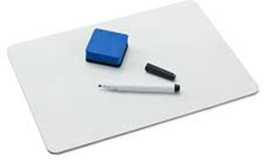
Review
Draw an example of a contact force | Draw and example of a non-contact force
Convert 10 kg to N | Explain how a spring balance works

Slide 3
Learning Intentions
Investigating the effects of applying different forces to familiar objects

Slide 4
Success criteria
List three factors that affect friction.
Explain that friction is a force that resists motion.
Explain how and why the mass of an object affects its friction.
Use repeat trials to calculate averages.

Slide 5


Slide 6
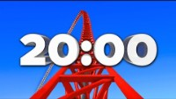
Practical Investigation: Friction and Mass
1 sheet per group
Each group will write their results on their own sheet and on the board, so we can do a class average.
We will practice graphing together, so everyone needs to have results
before the timer runs out!

Slide 7
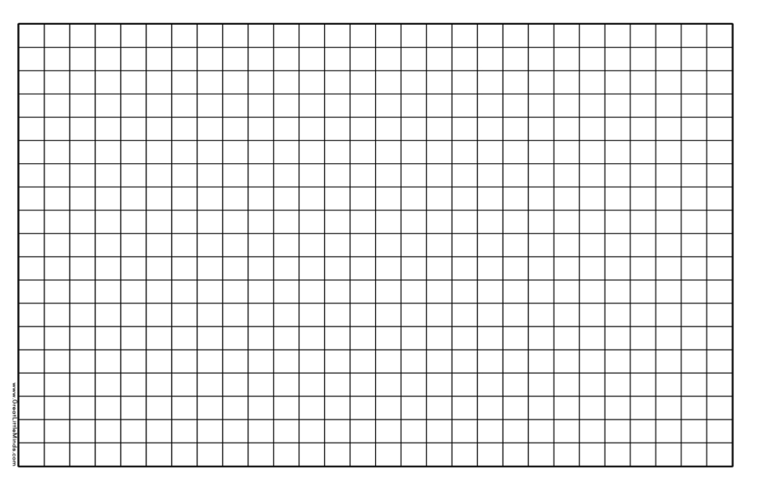

Slide 8
Success criteria
List three factors that affect friction.
Explain that friction is a force that resists motion.
Explain how and why the mass of an object affects its friction.
Use repeat trials to calculate averages.

